Slide 1

Savings management system
Mini project

Slide 2
Savings management system
Under guidance of-
Prof. name- Dr. Vrinda Sachdeva
I.T.S Engineering college
By Aryan gaur
(CSE)
2002220100042

Slide 3
CONTENT
1. Importance and Need of Savings
2. Objective
3. Working principle and Methodology
4. Concepts used in program
5. Construction and Assembly
6. Conclusion

Slide 4
Importance and Need of Manage Savings
It gives you freedom to pursue your dream career.
It gives long term security.
Helps in Emergencies.
It reduces stress.
Sponsor your own Education.
Minimizing Financial Risk.
It gives Financial Independence.
Gives independence Big Purchases.
Leaving A Financial Legacy.
Saving For Fun.

Slide 5
Objective
This program will help you to manage your savings by keeping in track your transactions like withdraw money from your savings or deposit money in your savings and gives the idea where to invest your some savings with the help of your age.

Slide 6
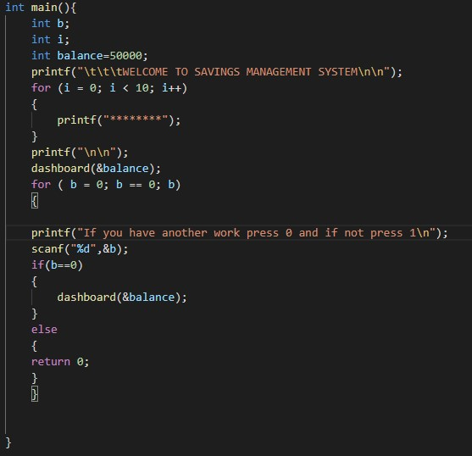
Code for main function
Initialize the balance and passes through pointer to dashboard and after that asked again and again until user exits.

Slide 7
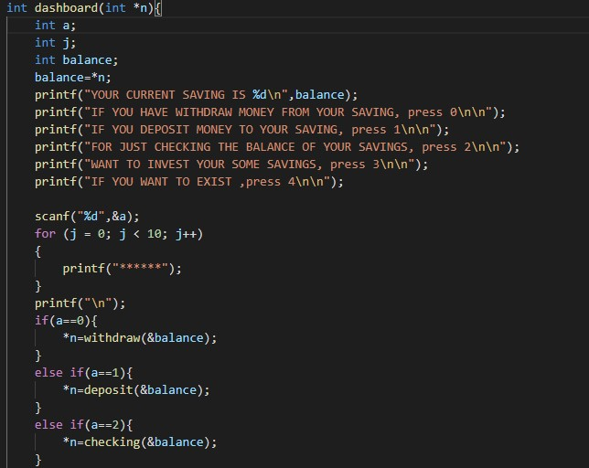
Code for Dashboard
Everything is controlled by dashboard, Using function actions are taken in their separate function and using pointers balance is passes through all functions and returns its value.

Slide 8
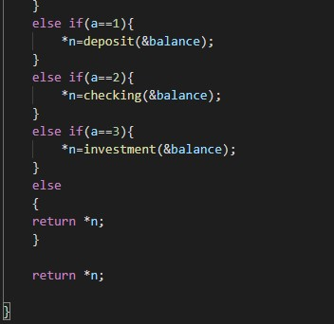
Code for Dashboard

Slide 9
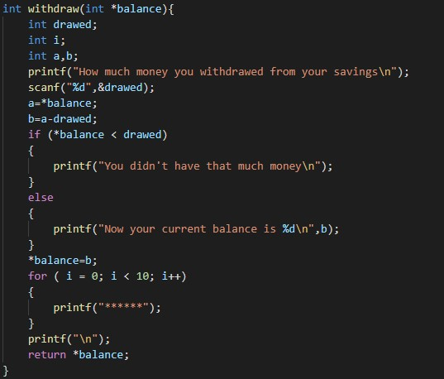
Code of withdraw
Passes the balance and asked for withdraw amount and subtract from original balance and displays current balance.

Slide 10
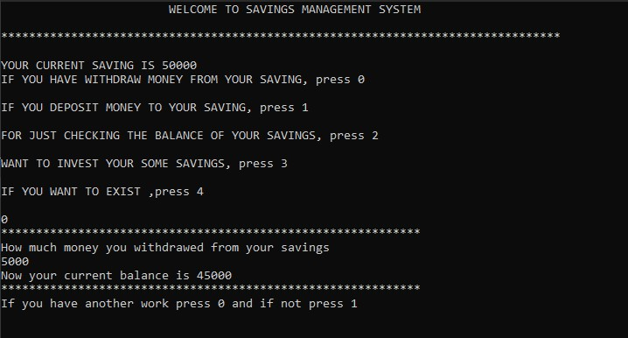
Output for withdraw

Slide 11
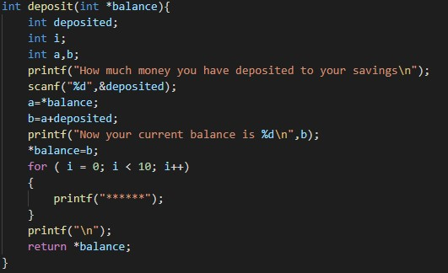
Code of deposit
Passes the balance and asked for deposited amount then added to original balance at last display them.

Slide 12
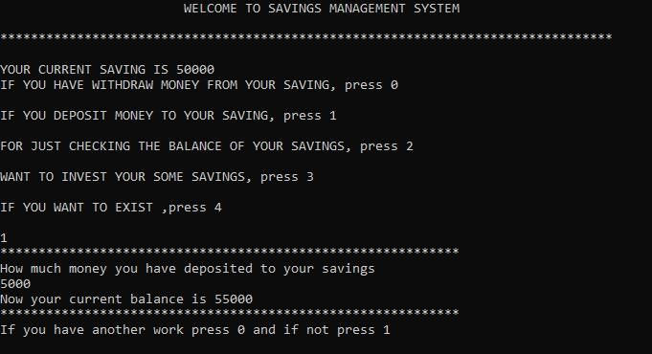
Output for deposit

Slide 13
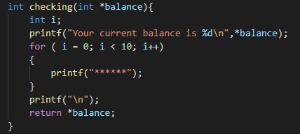
Code for Checking the balance
Passes the balance and displays it.

Slide 14
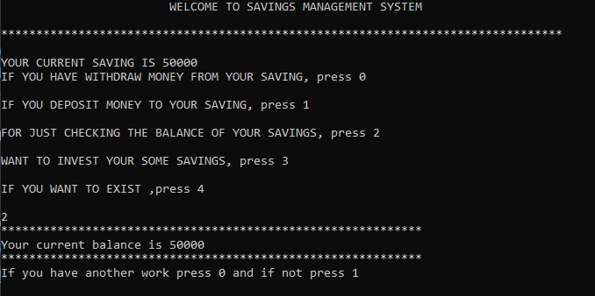
Output for Checking

Slide 15
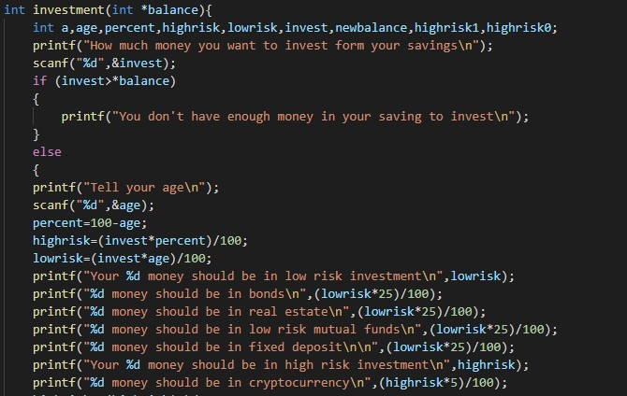
Code for invest savings

Slide 16
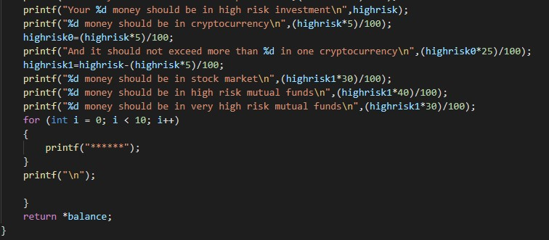
Code for invest savings
First passes the balance then asked for investment amount then users age then by subtracting age from 100 we get the investment to low risk and high risk then after that amount is further divided into different field percentage wise then displays them.

Slide 17
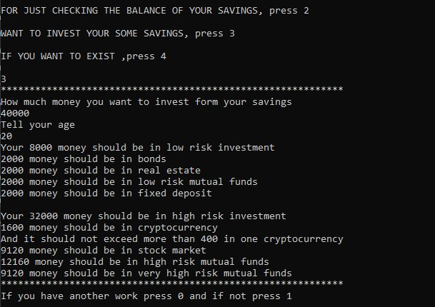
Output for savings investment

Slide 18
Concepts used in program
Condition statements
Loops
Functions
Pointers

Slide 19
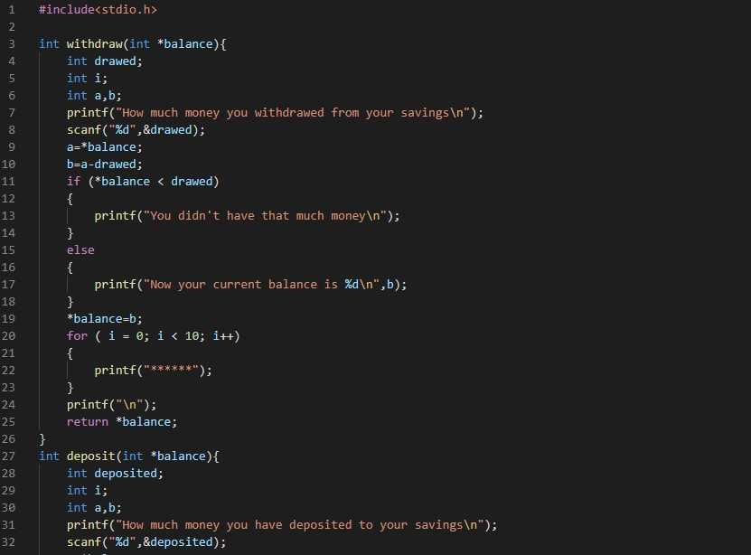
Whole code

Slide 20
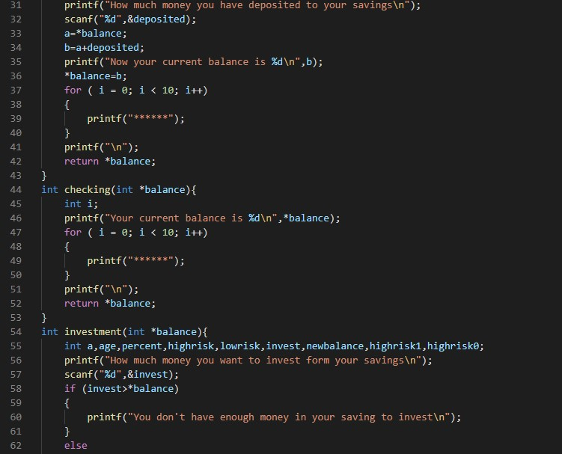
Whole code

Slide 21
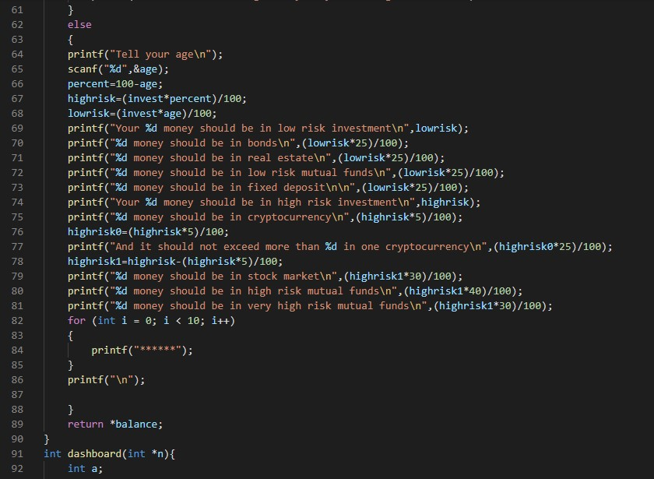
Whole code

Slide 22
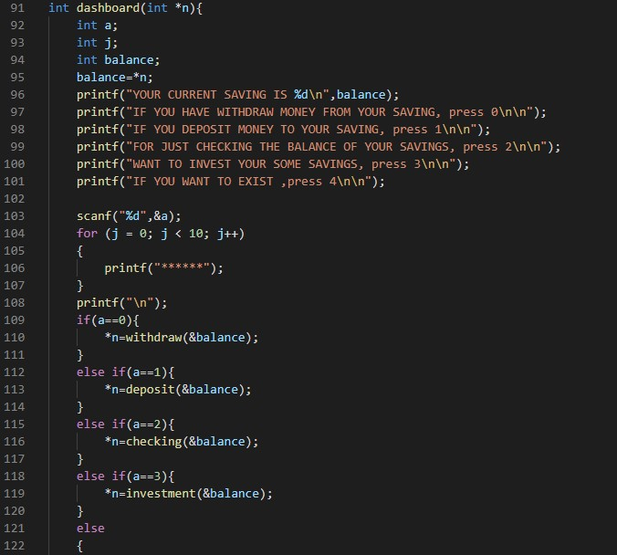
Whole code

Slide 23
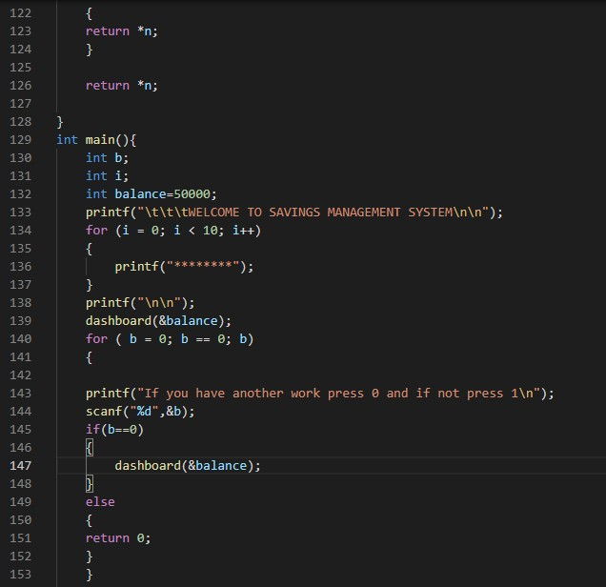
Whole code

Slide 24
Conclusion
Saving and investing some money is important because it provides security, stress relief, and freedom. And while there are countless reasons to save, you just need to find a reason that works with you. Whether it’s helping others, improving your finances, leaving a positive financial legacy, or just having a little more fun, you owe it to yourself to prioritize savings.

Slide 25
References
Google.
Previous Class notes.

Slide 26
Thank you

